Slide 1
FG1 – from raw data to science

Slide 2
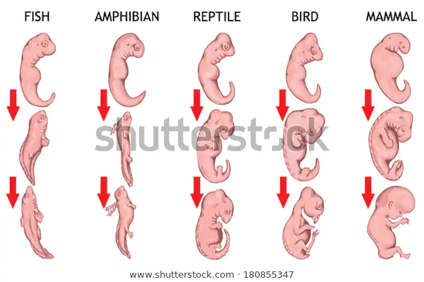
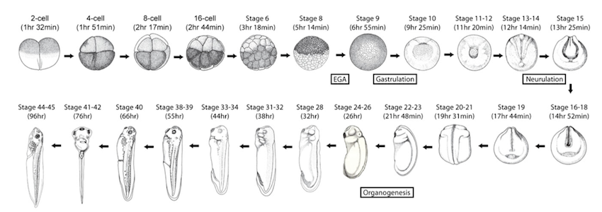
Hello world!
Xenopus developmental stages Tan et al. 2013
Remember this image from biology?
It suggests a similar path in embryogenesis
I want to know what those similar steps are
How?
Sequencing data from different species at different timepoint during embryogenesis
Create a map of gene-enhancer pairs by combining RNA-seq with ATAC-seq
Find conserved (de)activations per timepoint → conserved Gene Regulatory Networks (GRNs)

Slide 3
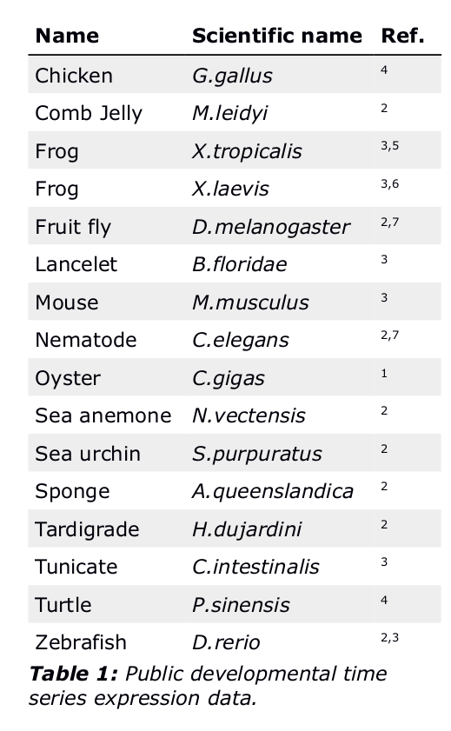

Hello world!
Manually analysing all this ----------------→ is a lot of work!
And I’m lazy…
To compare between species all steps must be the same
Automation!

Slide 4
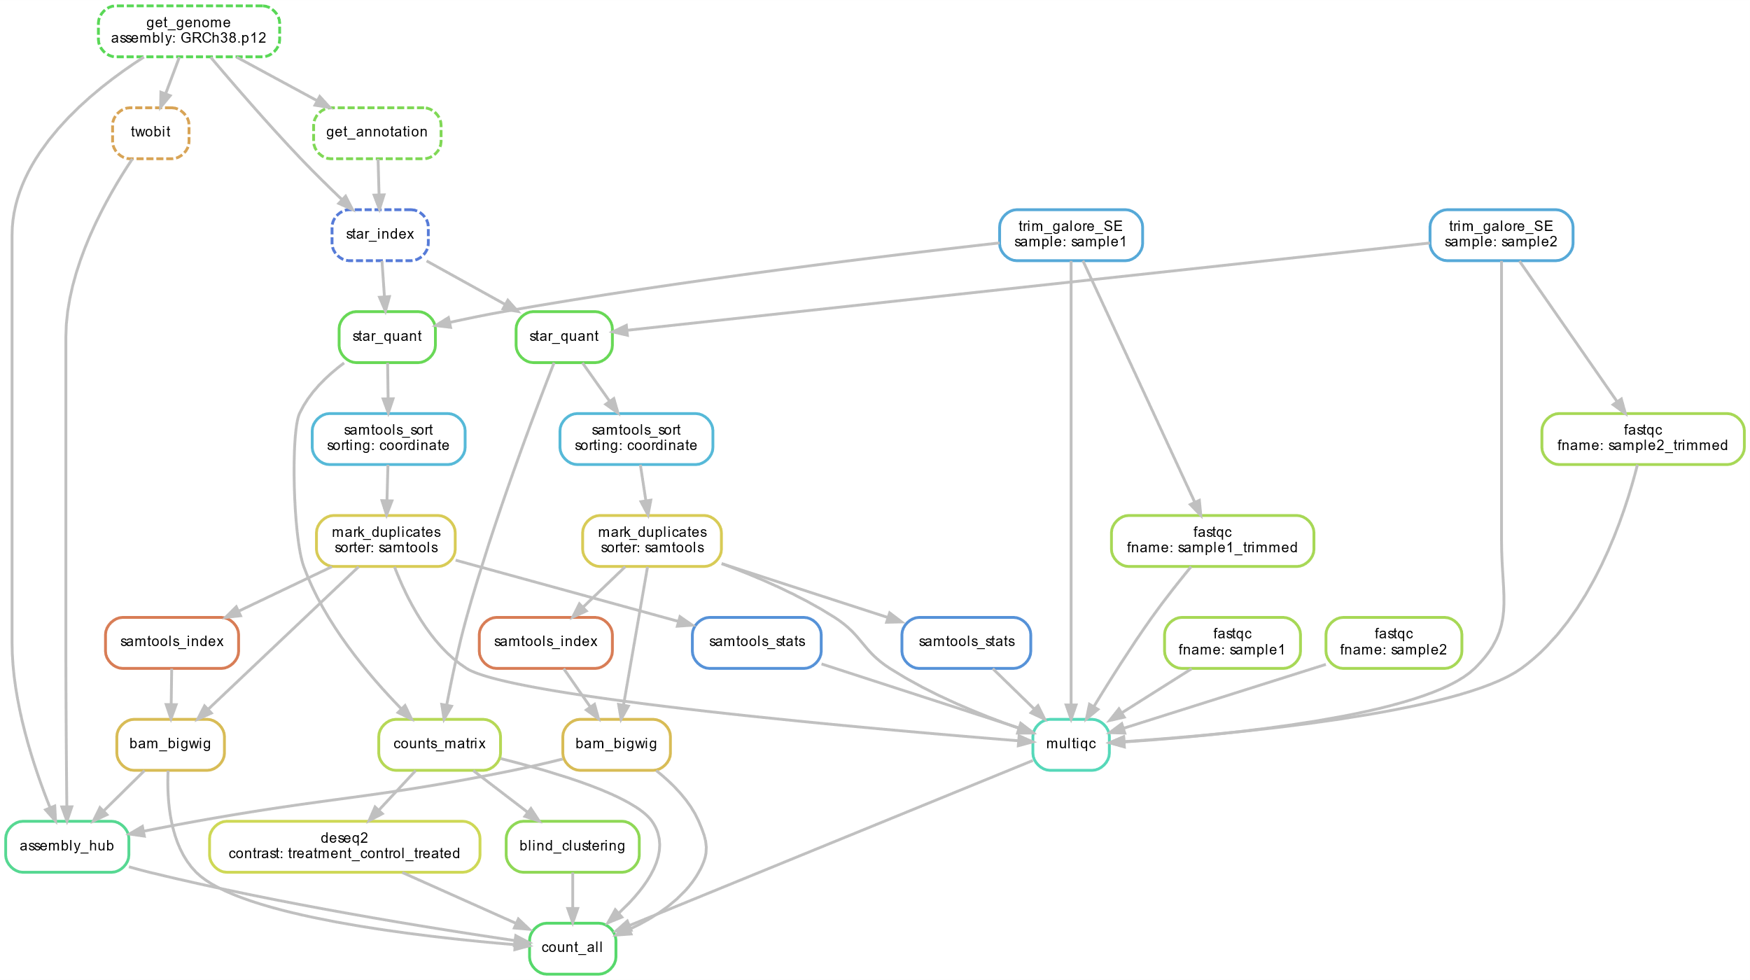
Automation: Pipeline
Automatic RNA-seq processing (https://github.com/vanheeringen-lab/snakemake-workflows)

Slide 5
Pipeline
Your sequencing data:
Adapter trimming
Sequence alignment
Aligned sequences
Gene counts
Duplicate marking
Meanwhile…
Quality checks
“Raw” fastq
Trimmed fastq
Duplicate marked fastq
Combined into one file
Gene counts:
Clustering
Differential gene expression
More analysis(?)
Aligned sequences:
Visualization files
Visualization

Slide 6
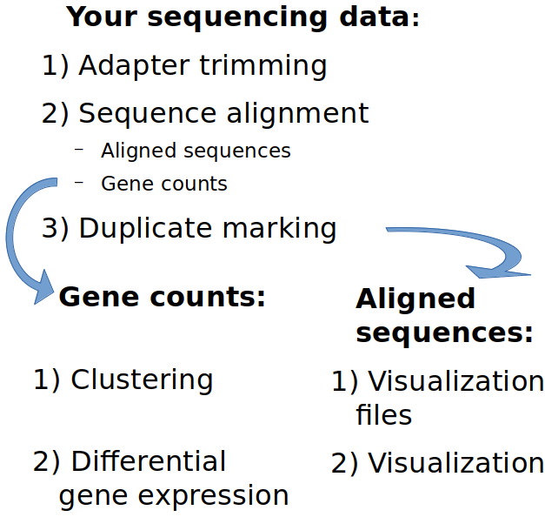
Pipeline
Input: your sequencing data
1) Adapter Trimming
2) Sequence Alignment
3a) Duplicate read marking
4a) Visualization
Output: BigWig files
3b) Gene counting
Output: counts table
4b) Differential gene expression
Output: list of different genes
Quality control steps
A) FASTQC
B) Sample clustering
Output: lots of pictures

Slide 7

Pipeline
Input: your sequencing data
1) Adapter Trimming
2) Sequence Alignment
3a) Duplicate read marking
4a) Visualization
Output: BigWig files
3b) Gene counting
Output: counts table
4b) Differential gene expression
Output: list of different genes
Quality control steps
A) FASTQC (MultiQC file)
B) Sample clustering
Output: lots of pictures
1
2
3a
3b
4a
A
B
4b
It looks like you’re trying to make sense of this jumble...

Slide 8
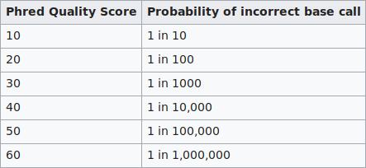
Pipeline
Your sequencing data
FASTQ file
Stores each read’s sequence, and the quality score of each nucleotide
Phred quality score (encoded)
Input: your sequencing data
1) Adapter Trimming
2) Sequence Alignment
3a) Duplicate read marking
4a) Visualization
Output: BigWig files
3b) Gene counting
Output: counts table
4b) Differential gene expression
Output: list of different genes
Quality control steps
A) FASTQC
B) Sample clustering
Output: lots of pictures
FASTQ line:
@very_unique_read_name ← sequence name
GCCATNTTTCTTCTGCACTTTCGTGACAGCTTTCNTNGAGCC ← nucleotide sequence
+ ← ???
AAAAA#EEEEEEEEEEEEEEEEEEEEEEEEEEEE#E#EEEEE ← nt quality ‘score’

Slide 9
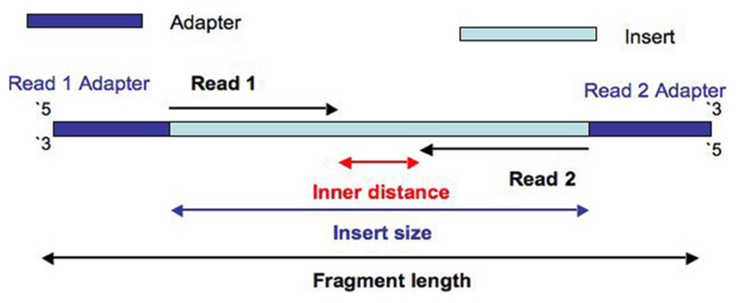
Pipeline
Your sequencing data
Paired-ended protocol
Sequences the RNA from both primers
Helps with indel detection
Doubles read depth
Each end is saved to a separate file
Input: your sequencing data
1) Adapter Trimming
2) Sequence Alignment
3a) Duplicate read marking
4a) Visualization
Output: BigWig files
3b) Gene counting
Output: counts table
4b) Differential gene expression
Output: list of different genes
Quality control steps
A) FASTQC
B) Sample clustering
Output: lots of pictures
Image source: https://www.biostars.org/p/106291/

Slide 10
Pipeline
Input: your sequencing data
1) Adapter Trimming
2) Sequence Alignment
3a) Duplicate read marking
4a) Visualization
Output: BigWig files
3b) Gene counting
Output: counts table
4b) Differential gene expression
Output: list of different genes
Quality control steps
A) FASTQC
B) Sample clustering
Output: lots of pictures
Adapter trimming
Adapter sequences are not interesting, so we cut them off
Tool: Cutadapt
Since adapters are standard, these can be easily identified
Low quality nucleotides are more likely to be wrong, so we cut them off too
Tool: Trim Galore!
Nucleotide quality is saved in the FASTQ files

Slide 11
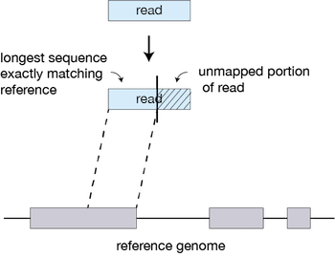
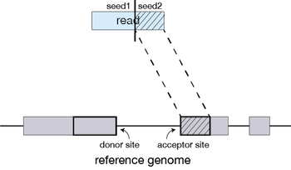
Pipeline
Input: your sequencing data
1) Adapter Trimming
2) Sequence Alignment
3a) Duplicate read marking
4a) Visualization
Output: BigWig files
3b) Gene counting
Output: counts table
4b) Differential gene expression
Output: list of different genes
Quality control steps
A) FASTQC
B) Sample clustering
Output: lots of pictures
Image source: https://hbctraining.github.io/Intro-to-rnaseq-hpc-O2/lessons/03_alignment.html
Sequence alignment
Find out where on the genome the reads came from
Tool: STAR
Difficulties:
mRNA = exons only
Multimappers (read aligns to multiple locations)
Sequencing errors

Slide 12
Pipeline
Input: your sequencing data
1) Adapter Trimming
2) Sequence Alignment
3a) Duplicate read marking
4a) Visualization
Output: BigWig files
3b) Gene counting
Output: counts table
4b) Differential gene expression
Output: list of different genes
Quality control steps
A) FASTQC
B) Sample clustering
Output: lots of pictures
Duplicate marking
A duplicate is a read that maps to the same gene as another read
Each read has a unique identifier
The number of identifiers is limited
So less duplicates is better
Duplicates can arise during library preparation
Some duplication is expectable
Determining duplicate percentage is important for quality control
Tool: Picard

Slide 13
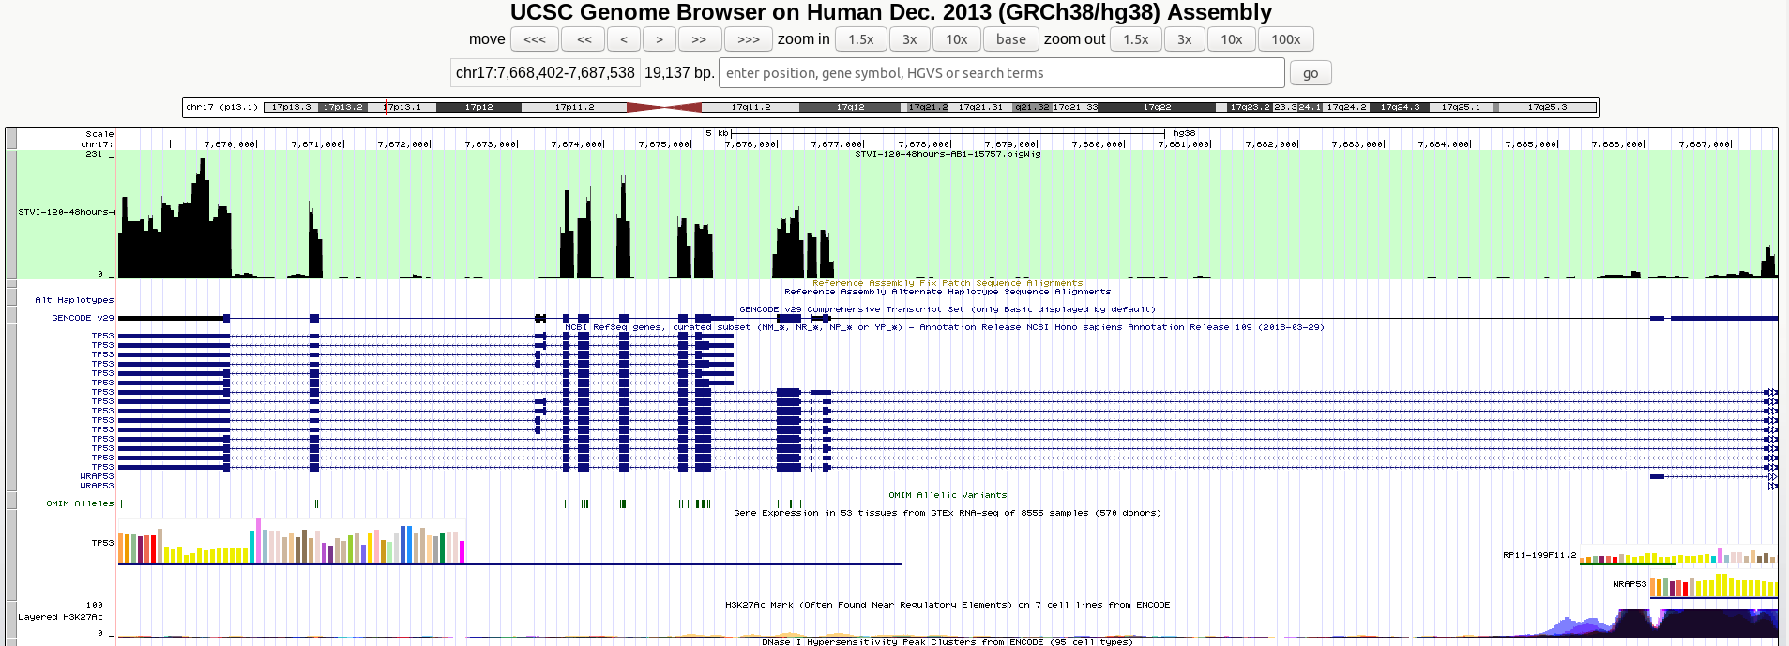
Pipeline
Input: your sequencing data
1) Adapter Trimming
2) Sequence Alignment
3a) Duplicate read marking
4a) Visualization
Output: BigWig files
3b) Gene counting
Output: counts table
4b) Differential gene expression
Output: list of different genes
Quality control steps
A) FASTQC
B) Sample clustering
Output: lots of pictures
Aligned sequences
Aligned sequences are sorted
Tool: Samtools
Outputs BAM files
To view these they must be converted
Tool: Deeptools
Outputs BigWig files
UCSC genome browser
See where our reads were aligned to the genome
Compare reads between samples

Slide 14
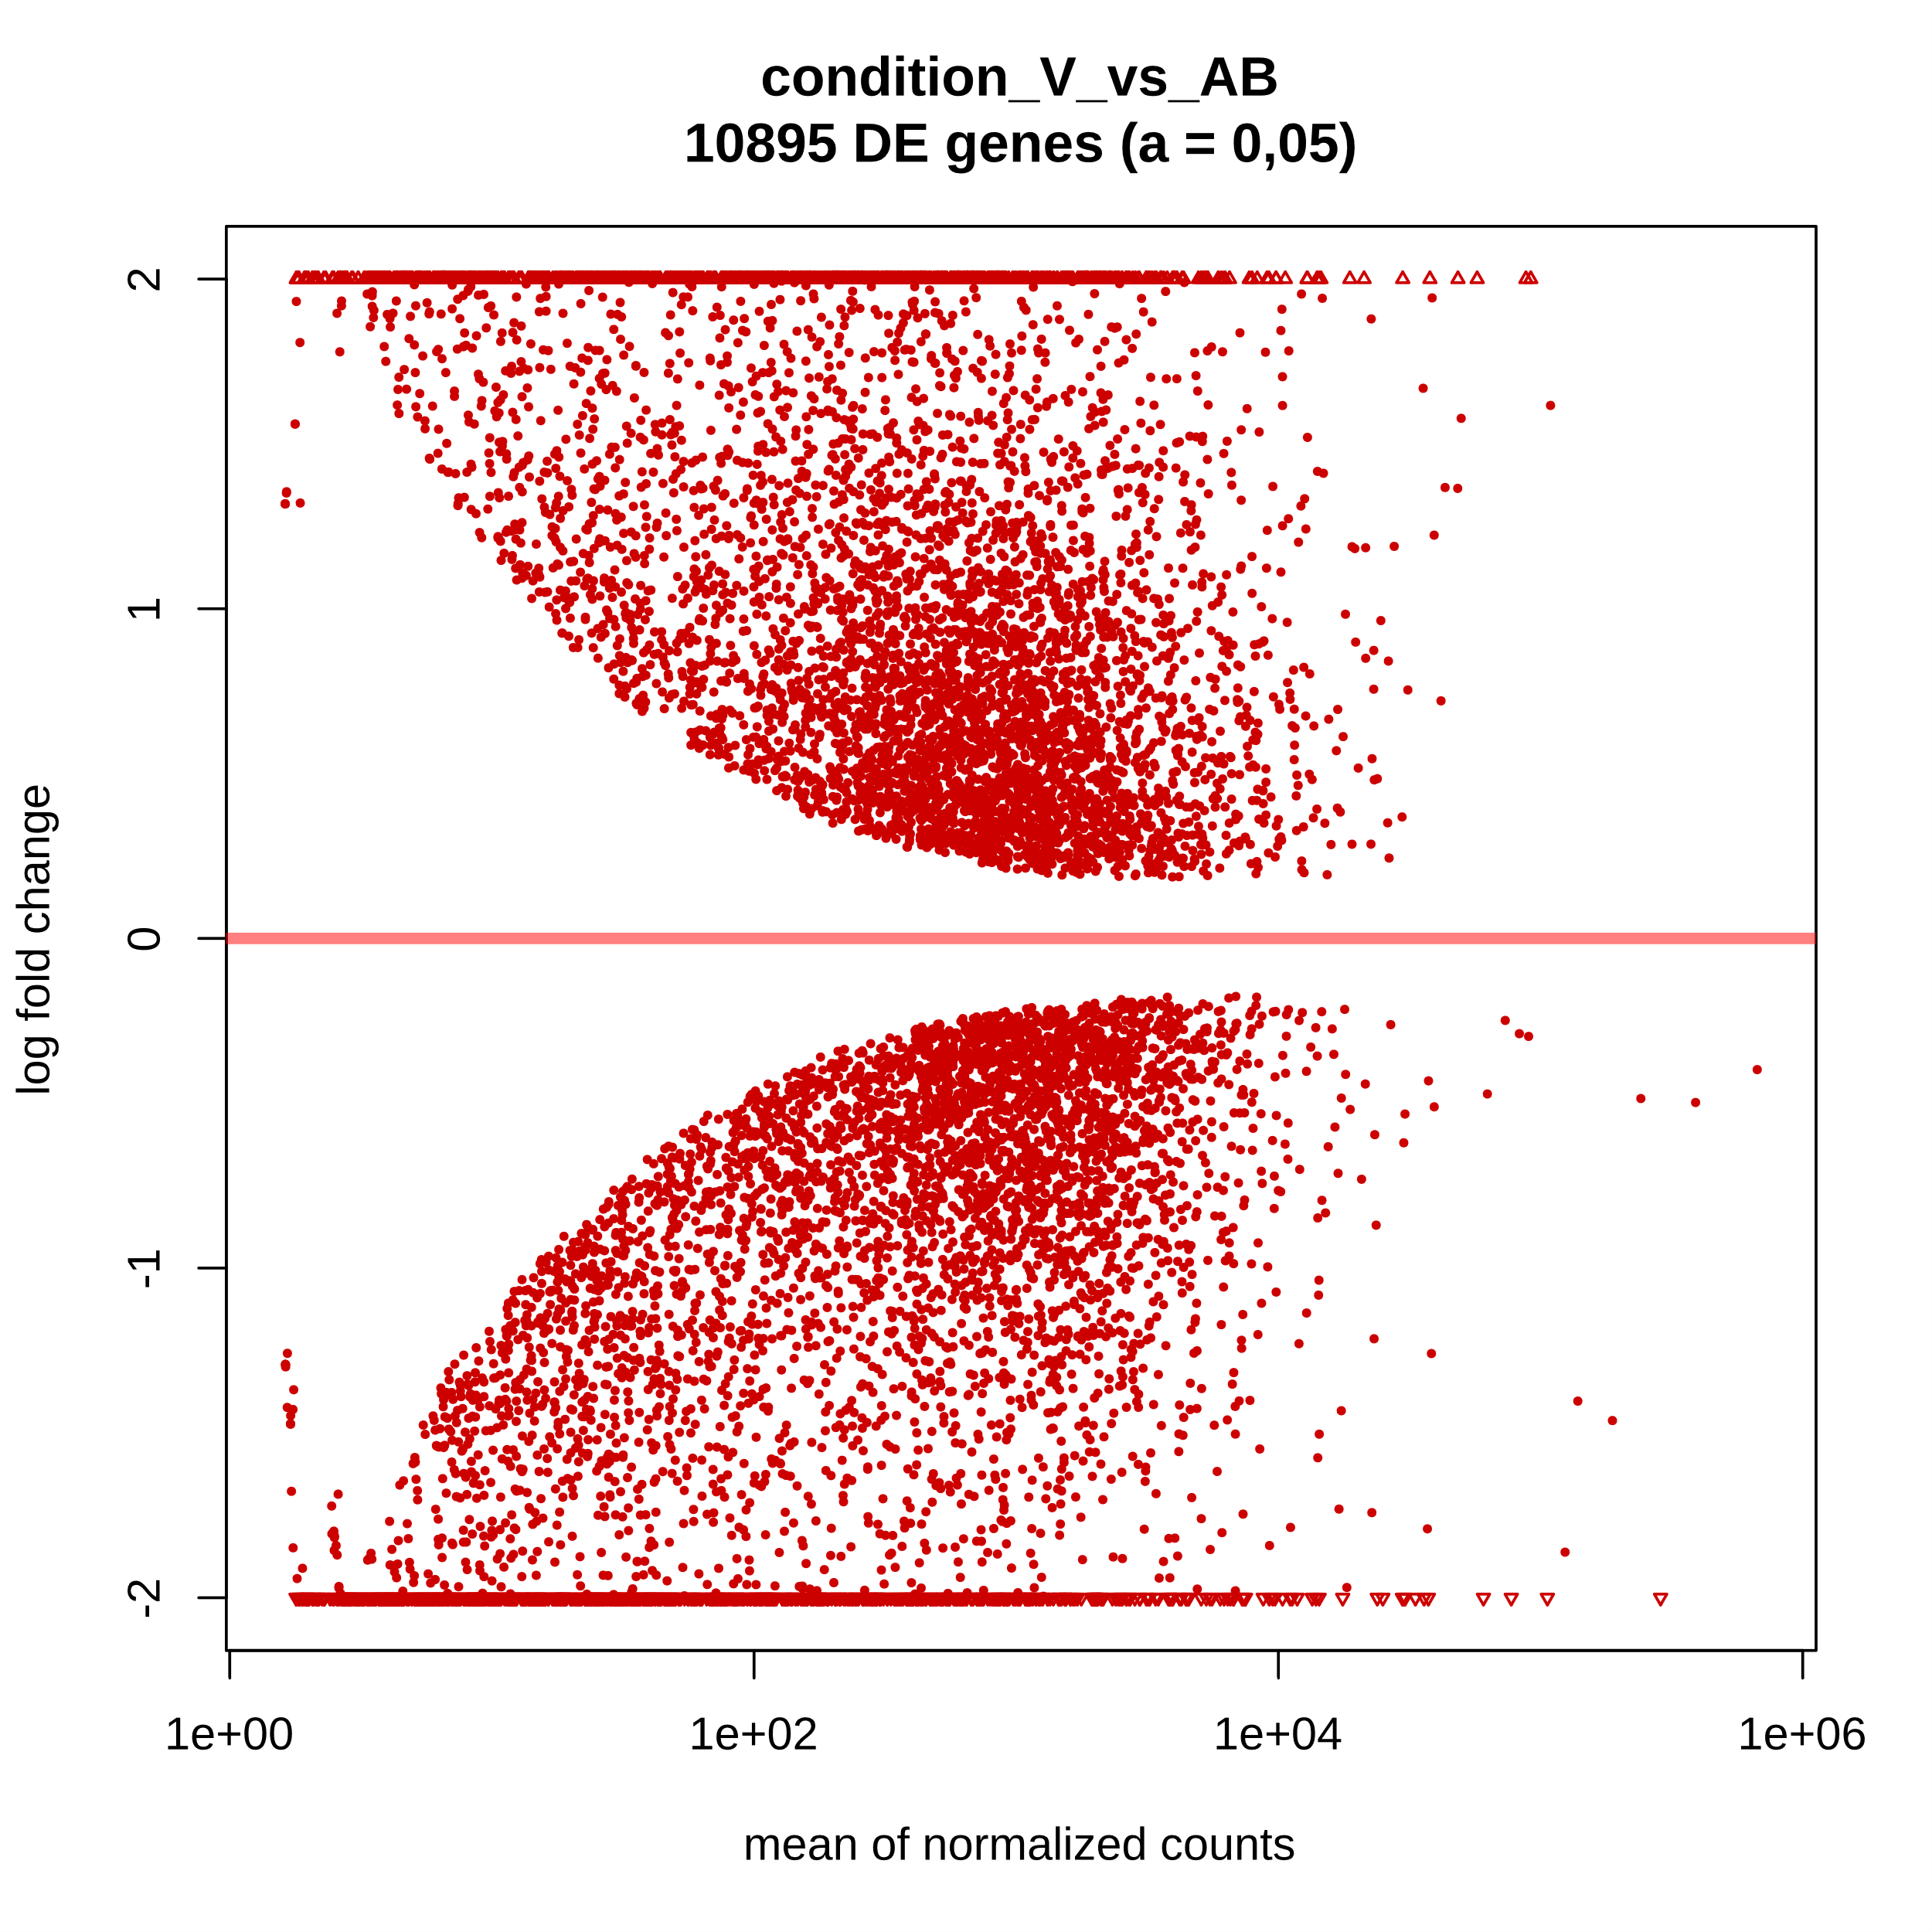
Pipeline
Gene counts
Estimating gene expression levels from RNA-seq
Difficulties:
Uneven read amplification per sample
Different exon usage per condition
Differential gene expression analysis
Compare gene expression between two groups of samples
Tool: DESeq2
For example:
Differentiated vs undifferentiated
Groups one’s samples vs group two’s samples
Input: your sequencing data
1) Adapter Trimming
2) Sequence Alignment
3a) Duplicate read marking
4a) Visualization
Output: BigWig files
3b) Gene counting
Output: counts table
4b) Differential gene expression
Output: list of different genes
Quality control steps
A) FASTQC
B) Sample clustering
Output: lots of pictures

Slide 15
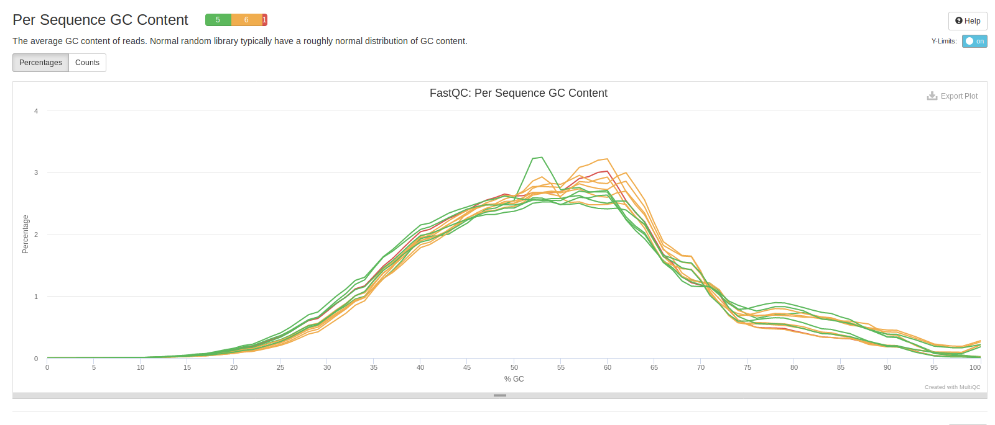
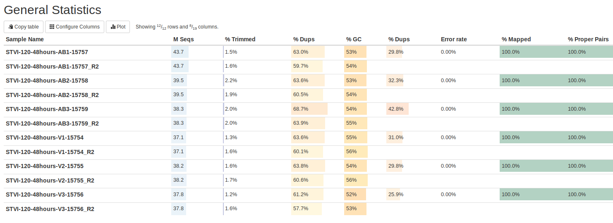
Pipeline
Quality control
Files are too large to look through manually.
FASTQC evaluates the intermediate files for us!
Measures how well sequencing went:
How many reads sequenced
How many reads are duplicates (remember 3a?)
GC percentage in the reads
And more
Input: your sequencing data
1) Adapter Trimming
2) Sequence Alignment
3a) Duplicate read marking
4a) Visualization
Output: BigWig files
3b) Gene counting
Output: counts table
4b) Differential gene expression
Output: list of different genes
Quality control steps
A) FASTQC
B) Sample clustering
Output: lots of pictures

Slide 16
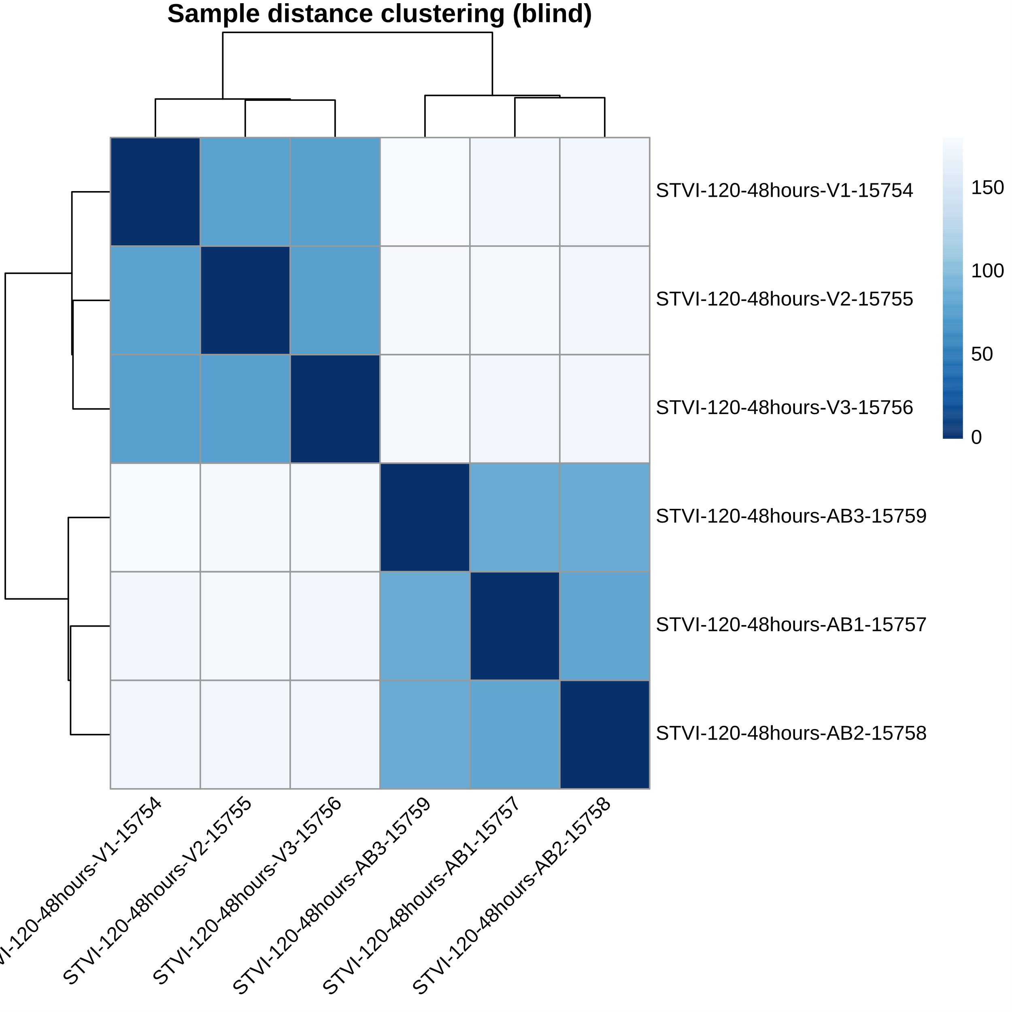
Pipeline
Sample clustering
Another form of quality control
Shows how different each sample is
All differentiated cells should be similar
All IPS cells should be similar
Can reveal
Switched samples
Contaminations
(Your) technical variations
Input: your sequencing data
1) Adapter Trimming
2) Sequence Alignment
3a) Duplicate read marking
4a) Visualization
Output: BigWig files
3b) Gene counting
Output: counts table
4b) Differential gene expression
Output: list of different genes
Quality control steps
A) FASTQC
B) Sample clustering
Output: lots of pictures

Slide 17
Pipeline
Latest version of the human genome: GRCh38.p12
Genome Reference Consortium Human Build 38 patch release 12

Slide 18
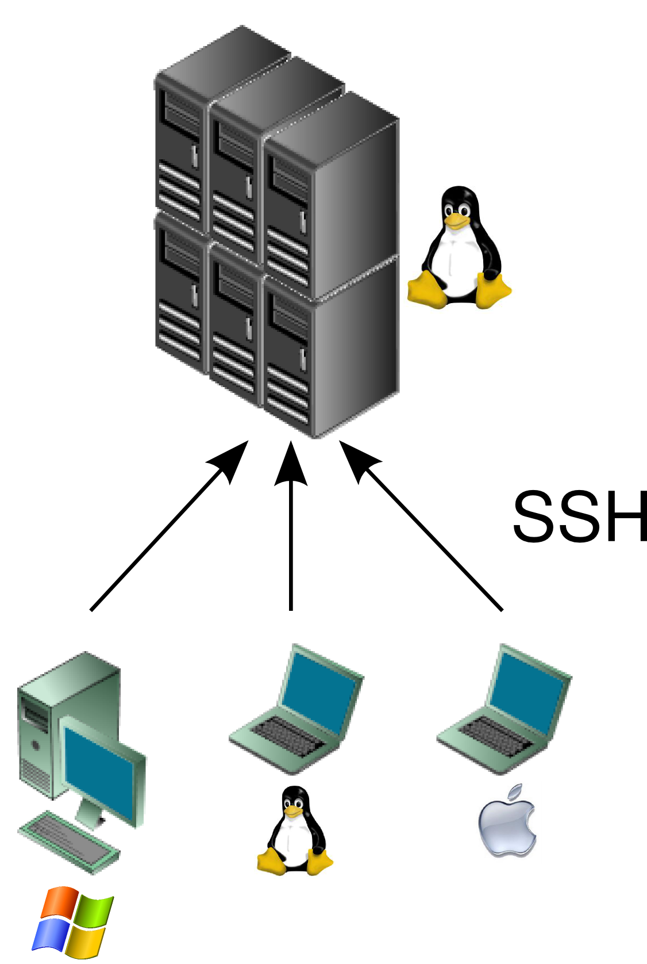
Server: mbscourse
Running the pipeline
Connect to server
Perform analysis remotely
Server can have lots of memory and CPU

Slide 19
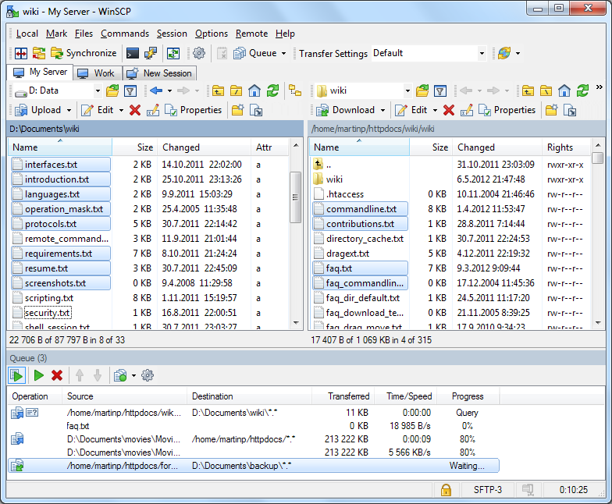
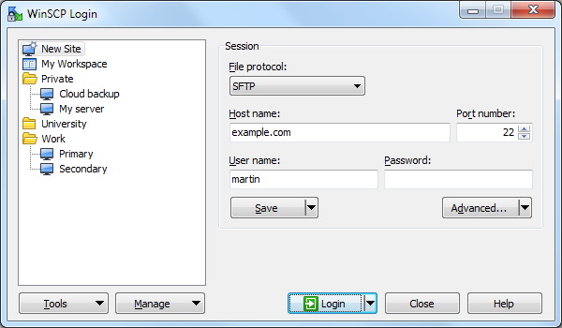
Server
Connecting to the server from windows
2 options:
Tool: WinSCP
Host: mbscourse.science.ru.nl
User name: science account
Tool: Putty

Slide 20
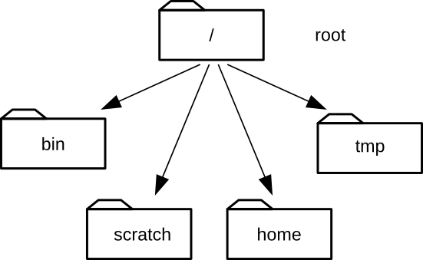
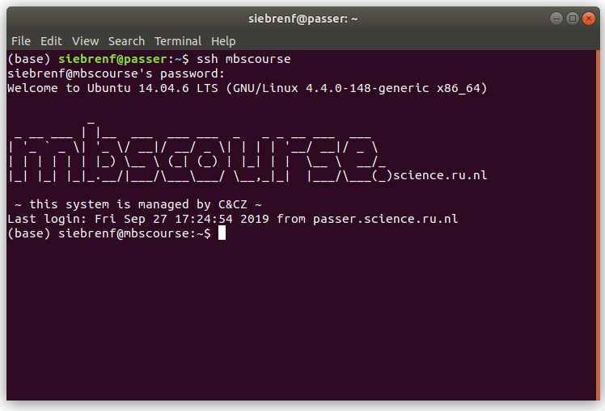
Server
mbshome

Slide 21
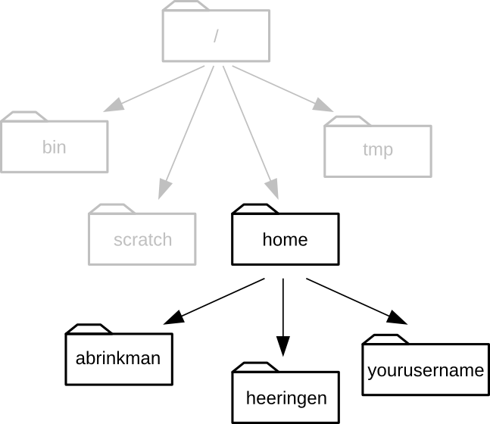
Server
mbshome
siebrenf

Slide 22
Server
Today:
Collect all fastq files in one location
Give all files consistent, descriptive (and machine readable) names
Machine readable:
No spaces (“ ”), but you can use underscores (“_”)
No special characters (“/” or “|” etc.)
Make a “metadata” table
Sample
Lab group
type (“undifferentiated” or “keratinocyte” or similar)
Other columns that you think we want to compare between!
Activate the pipeline!

Slide 23
Server
After the pipeline has finished:
Quality control (MultiQC)
Visual inspection (UCSC genome browser)
Differential expression analysis (DESeq2 in R)
Go term analysis (DAVID/other)

Slide 25
Some important Linux command
Commands all work the same:
[command_name] [optional flags] [argument1] [argument2] [etc]
Example: copying a file from one location to another
Copy command: cp
How cp works: $ cp --help
In short: $ cp [origin] [destination]
$ cp /mbshome/siebrenf/evil_cat.jpg /scratch/ghe_2019/evil_cat.jpg

Slide 26
Some important Linux command
ls: list all files in my current ‘directory’
Each ‘directory’ is a ‘map’ or ‘folder’
Each directory contains files, like the picture ‘evil_cat.jpg’
cd: Change Directory
cat: Show the contents of the file
nano: Opens a (very simple) text editor

Slide 27
Pipeline
Installing anaconda
Go to your home directory
$ cd ~
$ sh /mbshome/siebrenf/Anaconda3-2019.07-Linux-x86_64.sh
Say yes to everything
Copy some settings files (makes it easier to start again later)
$ cp /mbshome/siebrenf/.bash_profile ~/.bash_profile
Setup the pipeline
$ conda env create -f /scratch/ghe_2019/snakemake-workflows/envs/snakemake-workflows.yaml
$ conva activate snakemake-workflows

Slide 28
Pipeline
Running the pipeline yourself
From /scratch/ghe_2019/snakemake-workflows/workflows/rna-seq
Copy config.yaml and samples.tsv
Edit them to suit your need
In config.yaml you can set the differential expression analysis!
In Snakefile, link to your config.yaml
$ cd /scratch/ghe_2019/snakemake-workflows/workflows/rna-seq
Test your setup
$ snakemake –use-conda -n
Run your setup
$ snakemake --use-conda --cores 18 --resources deeptools_limit=1

Slide 29
Pipeline
Trying DESeq2 for yourself
In Rstudio
On the server
Requires a ‘visual connection’ to the server
To start rstudio (from linux)
$ ssh -X mbscourse
$ xterm
$ rstudio

Slide 30
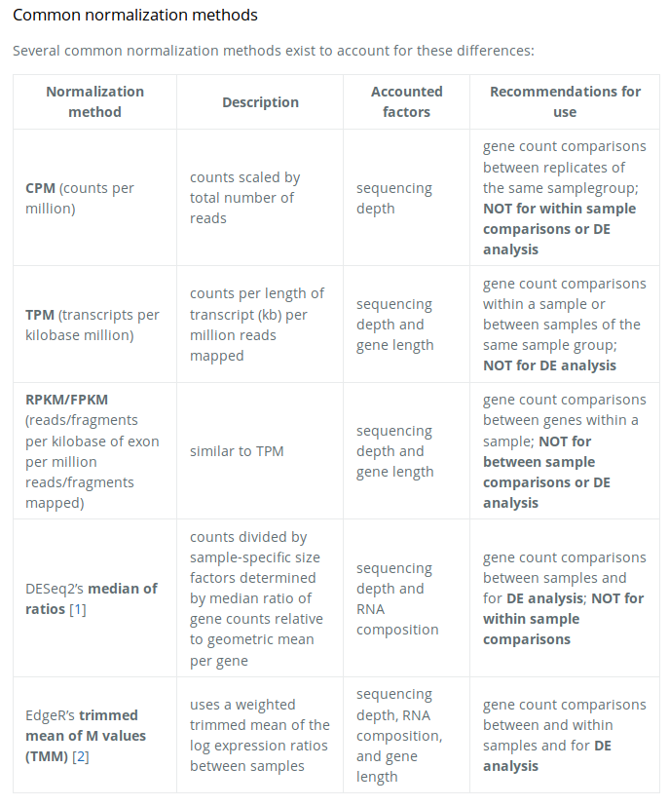
Pipeline
On gene count normalization:
image source: https://hbctraining.github.io/DGE_workshop/lessons/02_DGE_count_normalization.html

Slide 31
UCSC genome browser
Upload your bigwig file into the genome browser:
Go to the UCSC website
Under ‘My Data’, select ‘Custom Tracks’
Select ‘clade Mammal’, ‘genome, Human’ and ‘assembly Dec. 2013 (GRCH38)’
This should be correct already
In the box ‘Paste URLS or data’ paste links to all bigwigs you want to see
I need to ‘host’ your files in a special location. Here is one of Sabine’s bigwigs in that location
http://trackhub.science.ru.nl/hubs/siebrenf/GHE/GRCh38.p12/STVI-120-48hours-AB1-15757.bigWig
Click ‘Submit’, and in the next window click ‘go’
You are now brought into the genome browser.
Finally, find your sample name(s) on the left, right click and select ‘full’ (visibility)

